Slide 1
Muzz
Product Data Analyst Exercise
Product Analyst · Prepared for: Interview · Prepared By: Jide

Slide 2
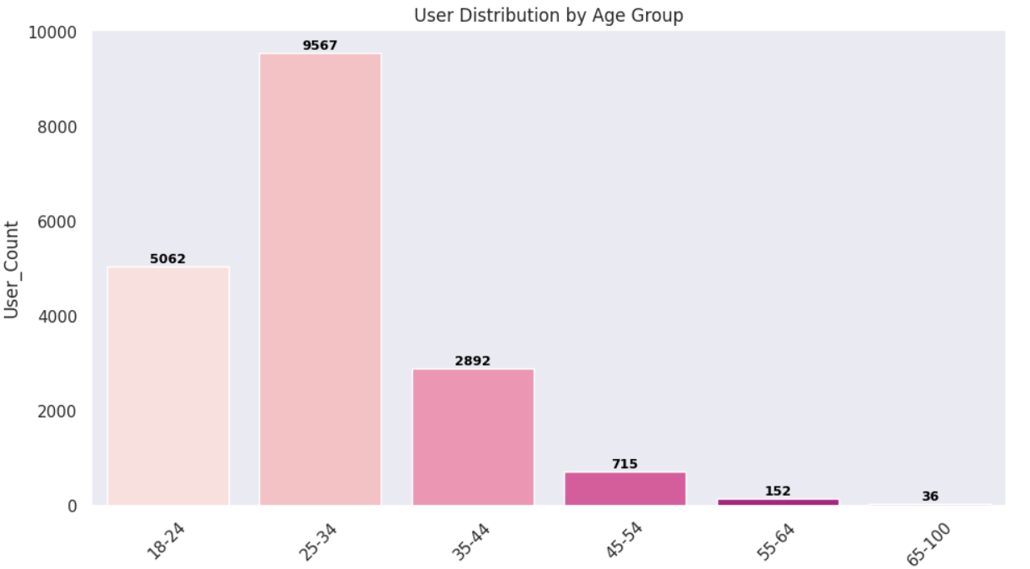
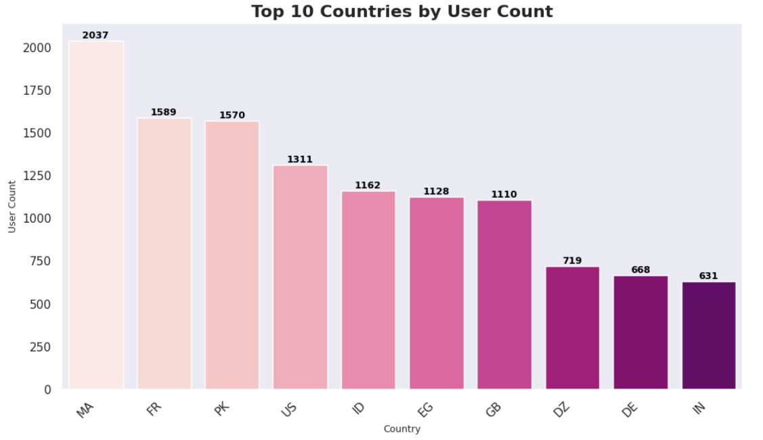
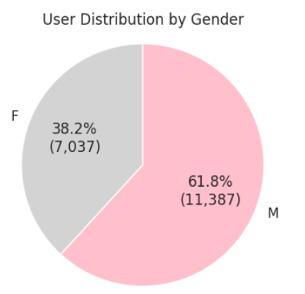
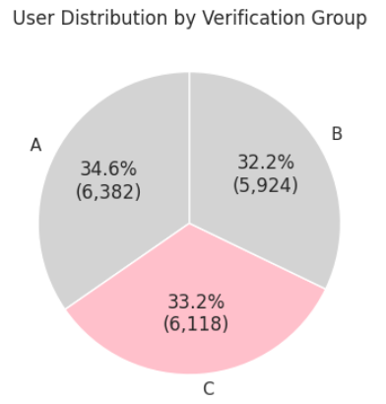
01 — User Verification Experiment Overview
Current Process: Users currently verify their accounts via SMS only after installing the app.
Goal: Increase user verification completion—i.e., successfully entering the OTP and progressing to profile setup.
Test Variants:
A (Control): Verify using SMS only (6,382 users)
B: Verify using SMS (primary) or WhatsApp (secondary) (5,924 users)
C: Verify using WhatsApp (primary) or SMS (secondary) (6,118 users)
Key Detail: The dataset records only the first verification method selected by each user; any subsequent changes are not captured.
Random Assignment: Each user is randomly assigned to one of the three variants.

Slide 3
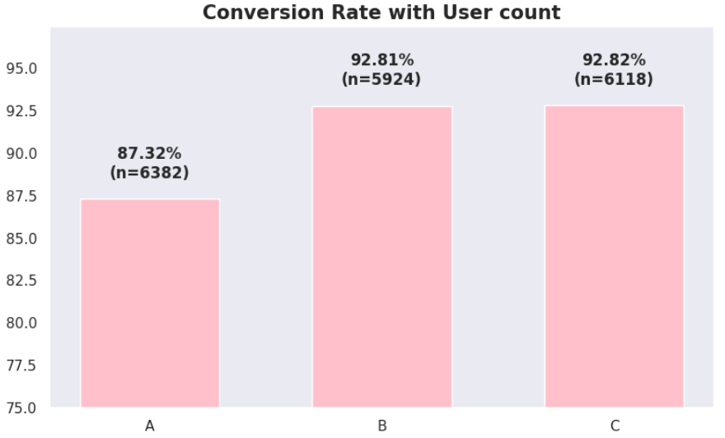
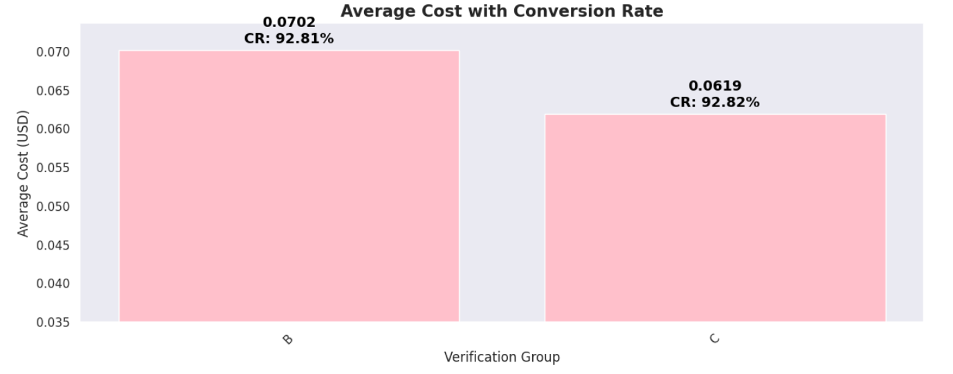
02 — Result Summary
Variant A (SMS only):
Shown to 6,382 users.
5,573 verified via SMS successfully, 809 refused.
Conversion rate: 87.3%.
Average Cost :$0.101042
Variant B:
Shown to 5,924 users: 5,257 chose SMS, 667 chose WhatsApp.
SMS: 4,888 verified, 369 refused → 92.9%
WhatsApp: 610 verified, 57 refused → 91.4%
Conversion rate: 92.81 %.
Average Cost :$0.0702
Variant C:
Shown to 6,118 users: 2,213 chose SMS, 3,905 chose WhatsApp.
SMS: 2,110 verified, 103 refused → 95.4%
WhatsApp: 3,569 verified, 336 refused → 91.4%
Conversion rate: 92.82%.
Average Cost :$0.0619

Slide 4
03 — Deliverables
Which screen would you suggest we proceed with ?
Screen C
2) Which success metrics you considered and why ?
Conversion Rate : Tells us did the feature improve user success and user’s preference.
Average OTP cost : Tells us is the improvement cost-effective.
3) Whether you would incorporate additional data if you could.
Yes, I would. I would incorporate time series data to analyse how the experiment performs over time and support a more robust conclusion. I would also include device type analysis to identify any friction points associated with different devices.
4) Why do you think your chosen screen performed best ?
Group C delivers the same conversion performance as Group B (~92.8%) but at a lower average cost per user (~12% cheaper). Given no meaningful difference in conversion, Group C is the most cost-efficient option and should be selected.
5) Would you recommend any additional changes to the screen ?
Yes, I would recommend a few targeted improvements, while being careful not to compromise the goal of identifying true user preference.
Keep variants clean: Ensure only the primary option (SMS vs WhatsApp) differs to avoid biased results.
Clarify hierarchy: Make primary vs secondary options visually clear and consistent.
Add light guidance: Indicate benefits (e.g. speed/reliability) to support informed choice

Slide 5
Muzz
Thank You
Product Analyst · Prepared for: Interview · Prepared By: Jide

